Slide 1
Finish
My task plan
Start
When I'm finished I can…
1
2
3

Slide 2
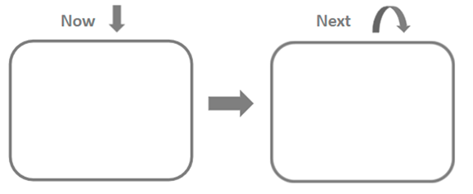

Slide 3
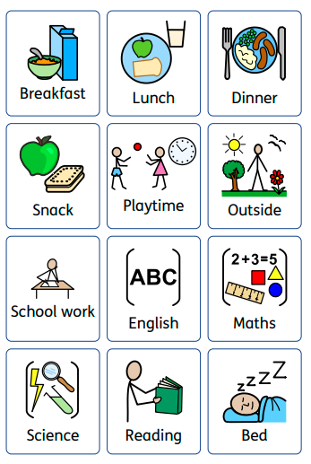

Slide 4
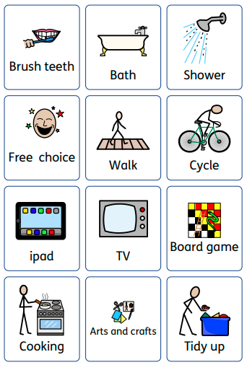

Slide 5
